Slide 1
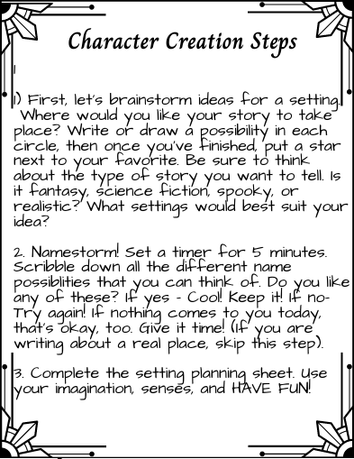
Setting Creation Steps

Slide 2
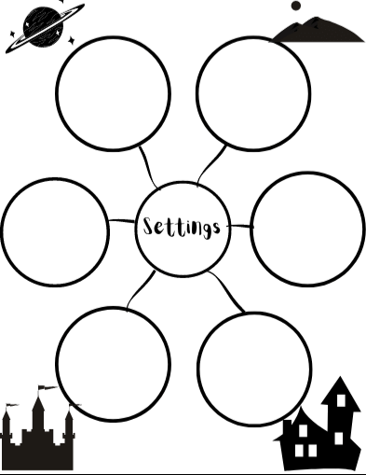

Slide 3
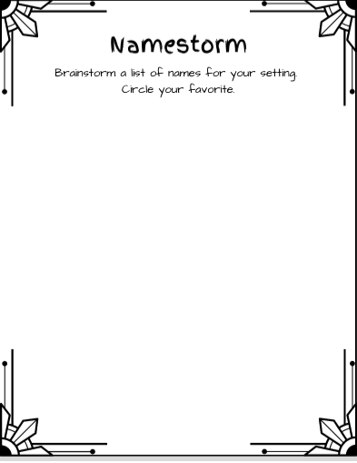

Slide 4
Setting Planning Sheet
Name ~
Type of Place ~
Weather ~
Time Period ~
Illustration

Slide 5
How Does It Look?
How Does It Smell?
What Sounds Can Be Heard?
How Does If Feel?
(Think temperature & textures)

Slide 6
Write a paragraph to describe and introduce the setting of your story.

Slide 7
Sketch a Map!

