Slide 1
Who do you want to be?
One of the most exciting things about
playing D&D is that you have the power to be WHOEVER you want. But, as we all know, with great power comes great responsibility and it can be tough to decide on a character.
So, how can you come up with the best character for you? First, let's do some brainstorming to find a good fit, After that, we'll work on finding the perfect name, designing a great look, and creating an interesting backstory.
Read on to find out how.

Slide 2
Character Creation Steps
1. First, let's choose your character's race ( (elf, human, gnome, etc). Write or draw a possible choice in each circle of the idea web. You can use The Player's Handbook, go to https://www.dndbeyond.com/races, or come up with ideas all your own. Once you've completed the web, put a star next to the one you feel most drawn to.
2. Next, repeat Step 1 using the Class web. Again, you can use The Player's Handbook, go to https://www.dndbeyond.com/classes, or ideas of your own.
3. Namestorm! Set a timer for 5 minutes. Scribble down all the different name possiblities that you can think of. Do you like any of these? If yes - Cool! Keep it! If no- Try again! If nothing comes to you today, that's okay, too. Give it time!
4. Complete the character sheet. Use your imagination and HAVE FUN!

Slide 3
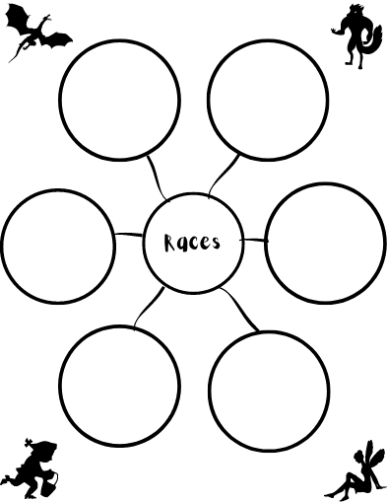

Slide 4
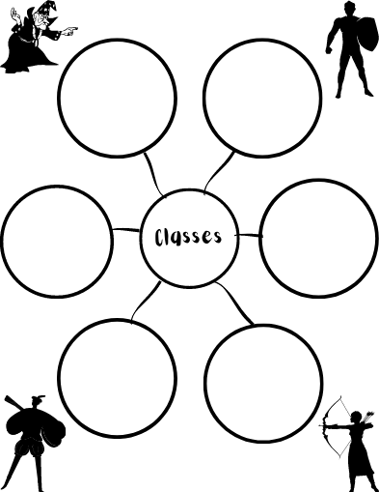

Slide 5
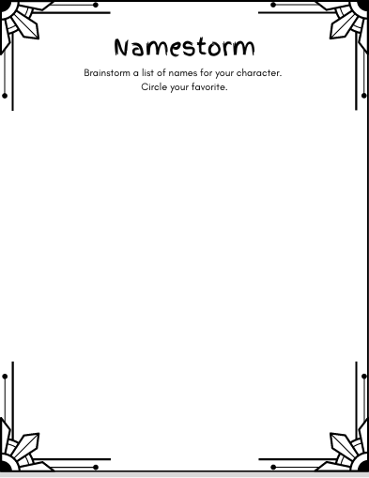

Slide 6
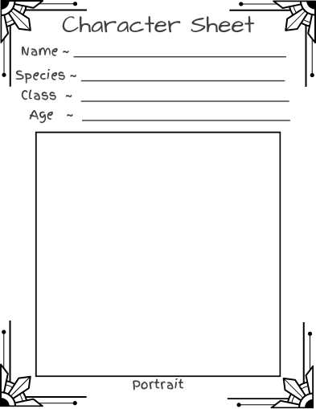

Slide 7
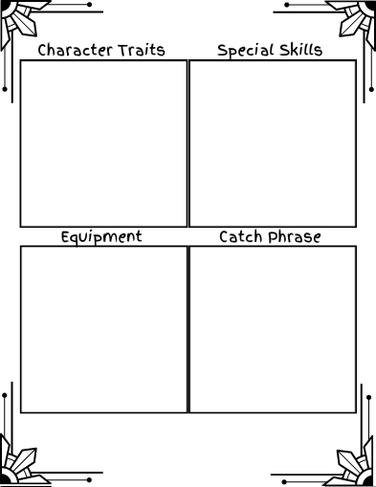

Slide 8
